Slide 1
Decision for Affordable/Social Housing (DASH) System

Slide 2
Introduction
The project is about a prototype system called Decisions for Affordable/Social Housing (DASH). DASH is an innovative effort to address informational gaps in social housing databases. DASH aims to give stakeholders with actionable insights into housing patterns, prevent homelessness, and forecast future demand for social/affordable housing by developing a data-driven open system.

Slide 3
GOALS
Database constraints
To create meaningful data, database constraints must be added.
Data Synthesis
Using dbForge data generator tool to generate and insert synthetic data into Azure SQL Database.
Dashboard generation
Visualizing relevant features of the generated data to gain insights.
Predictive analytics
Using Azure ML Studio to estimate future trends based on the generated data.

Slide 4
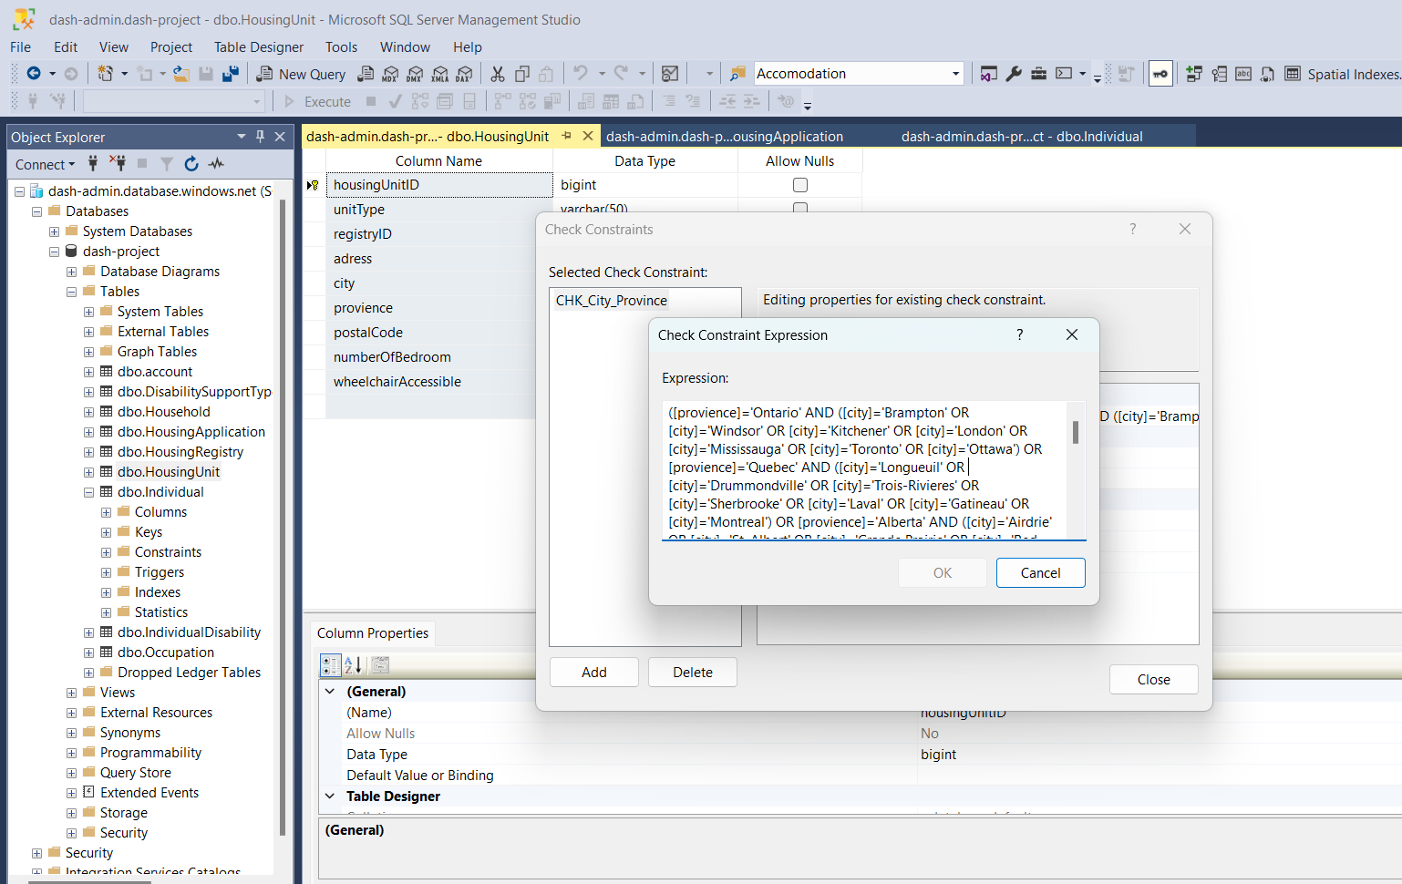
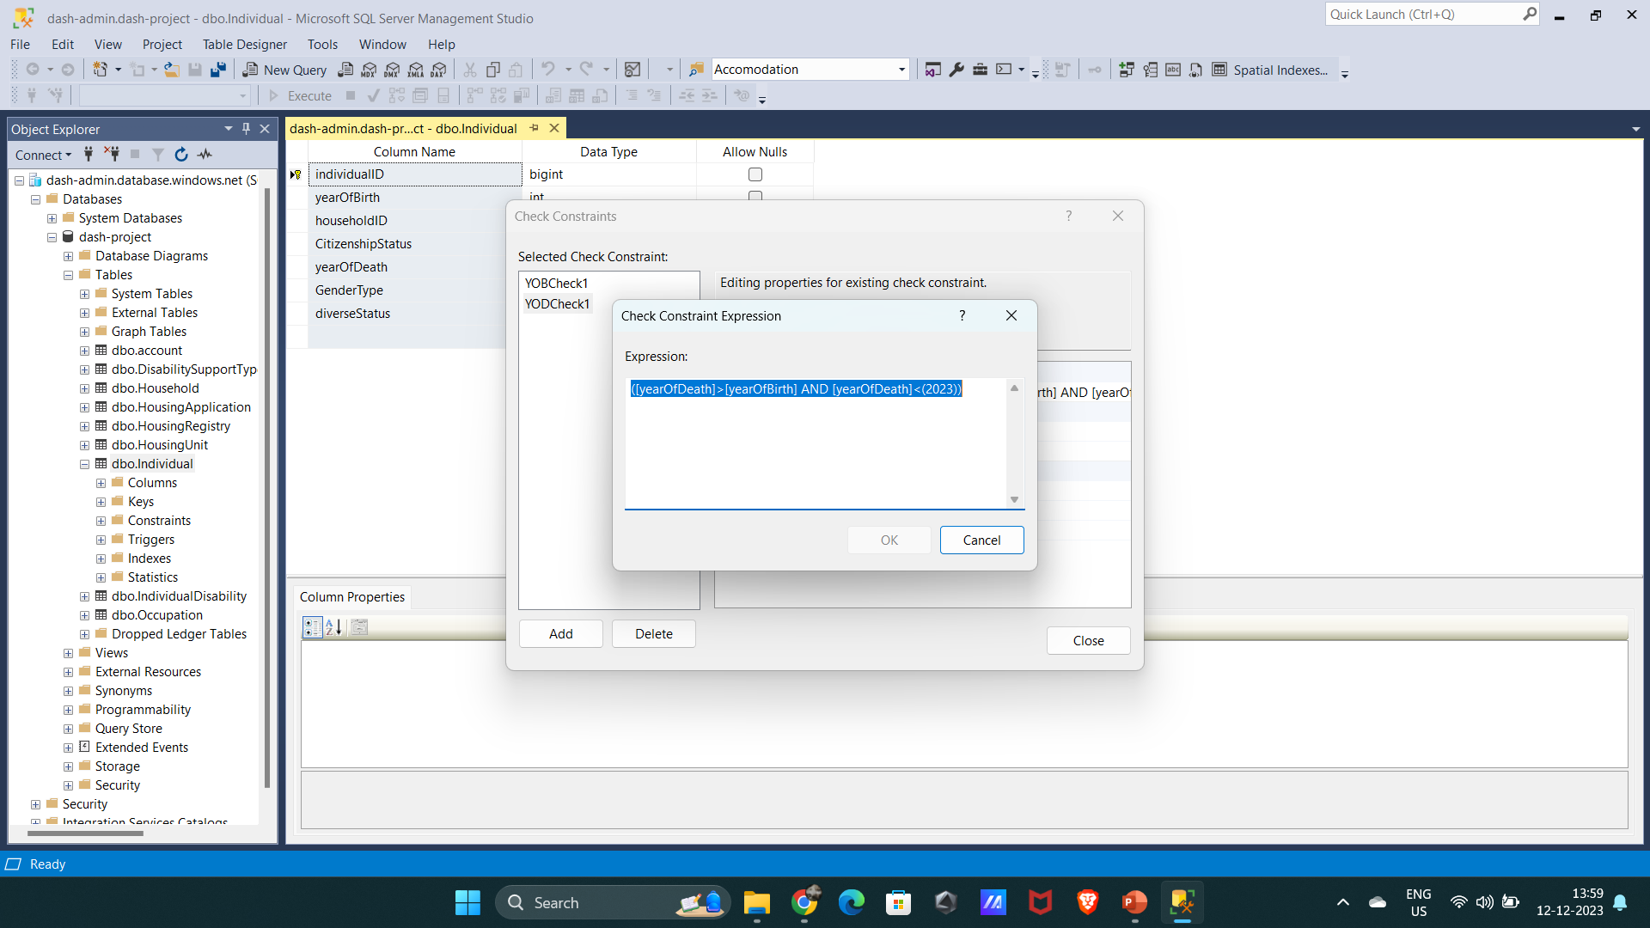
Database constraint

Slide 5
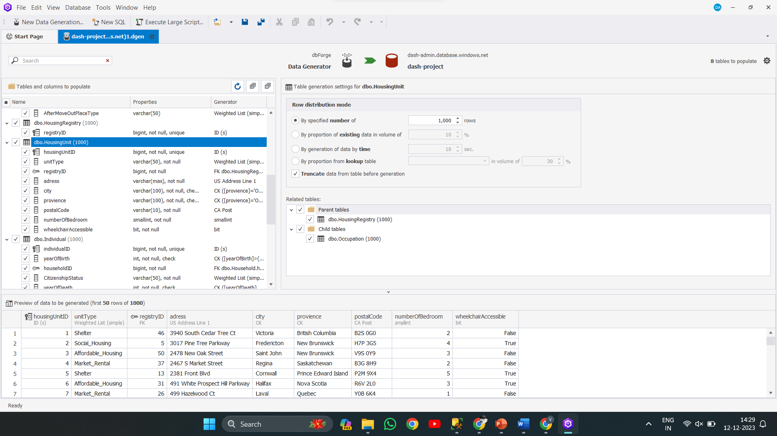
Data Synthesis

Slide 6
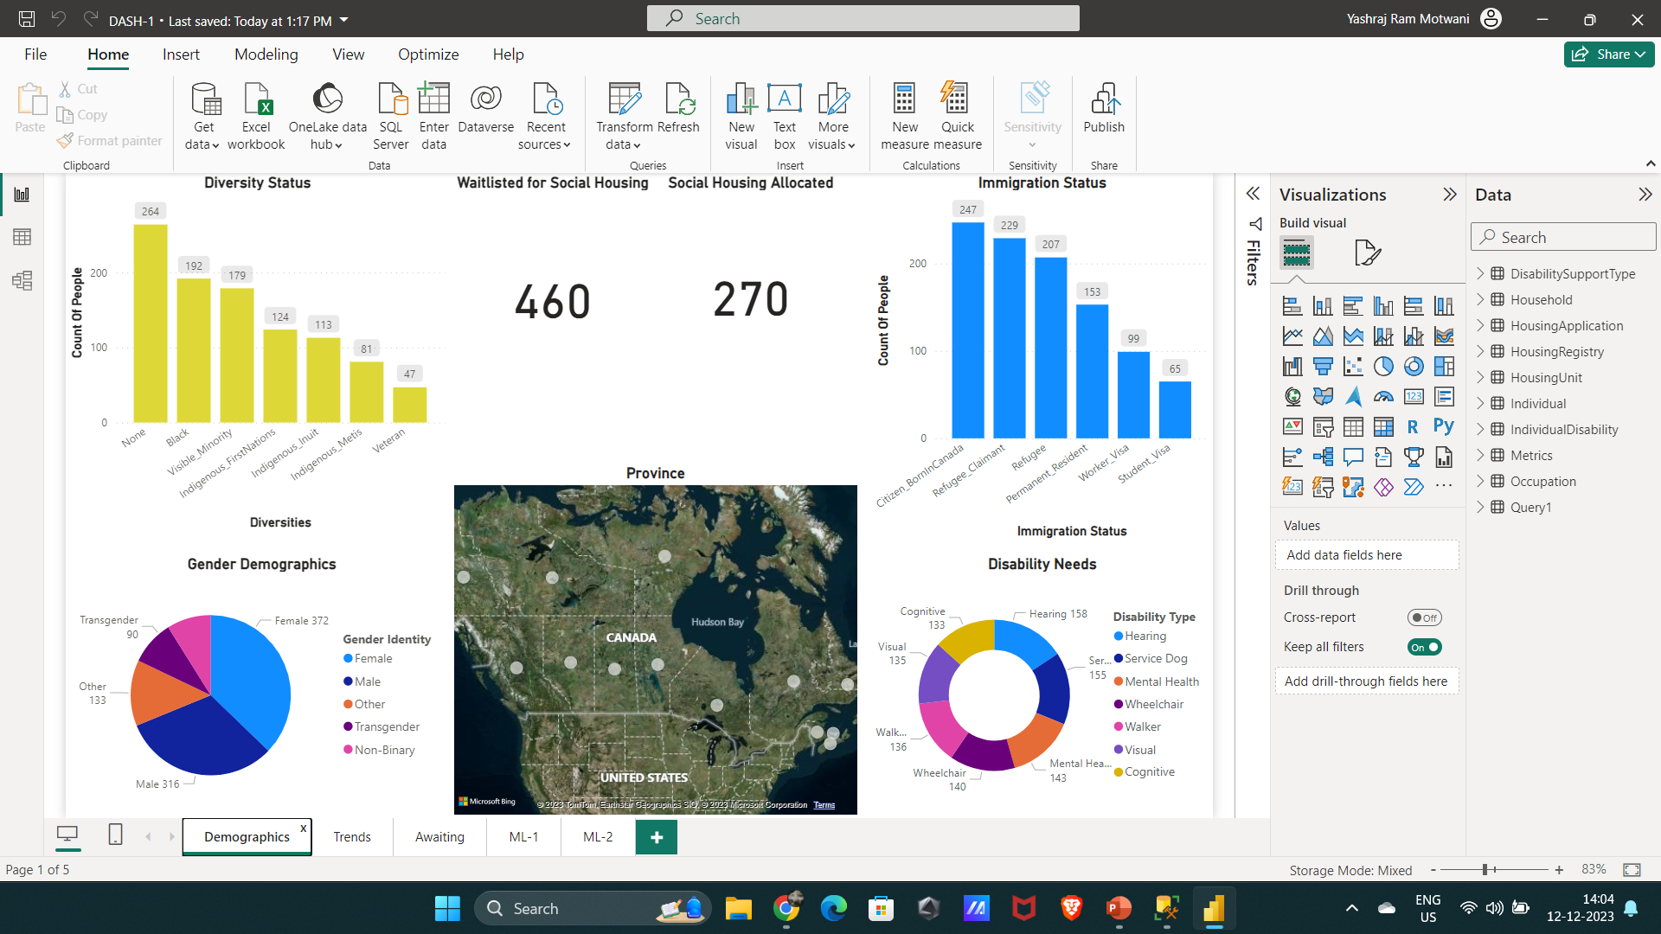
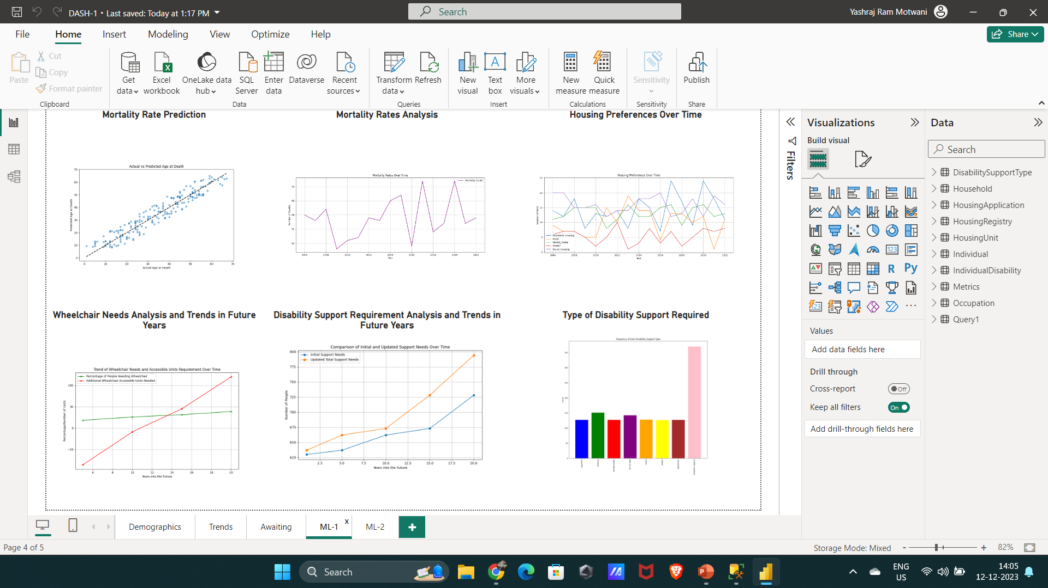
Dashboard generation

Slide 7
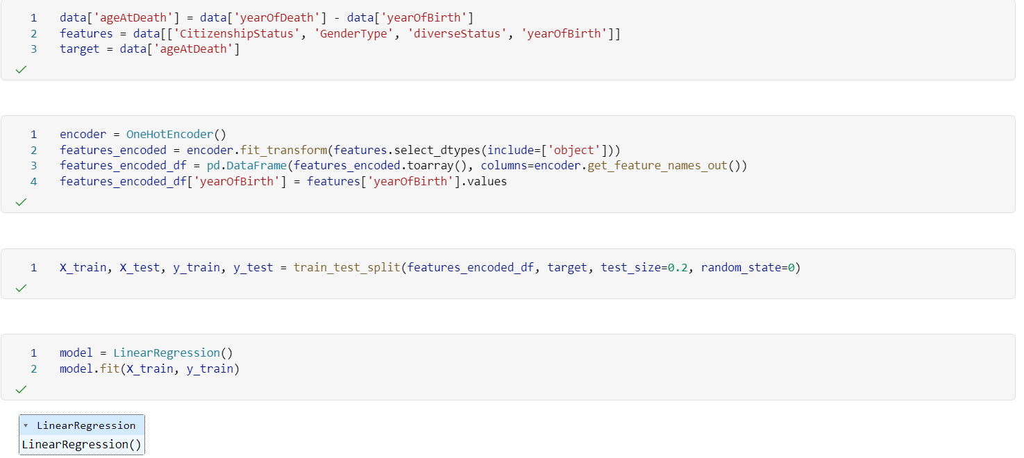
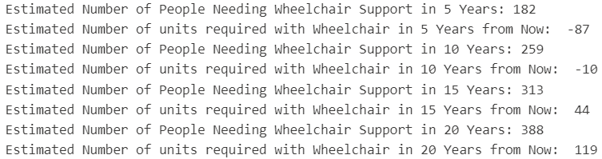
Predictive analytics

Slide 8
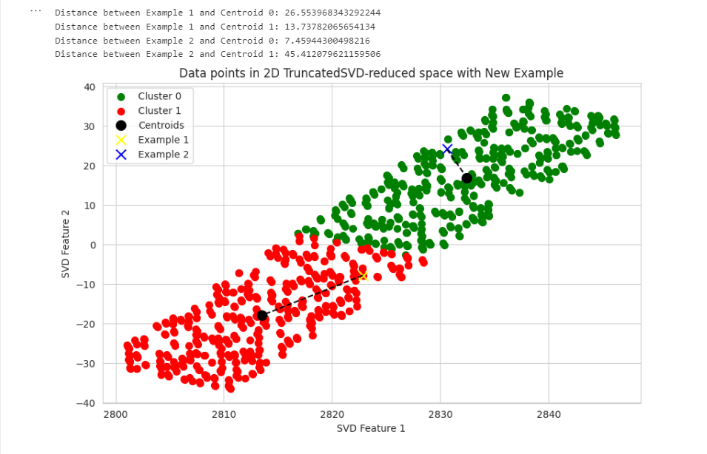
Predictive analytics

Slide 9
THANK YOU

